Slide 1
Drawing with perspectives
How to draw a room, step by step.

Slide 2
Each student need the following items:
A4 paper, long ruler, pen och rubber.

Slide 3
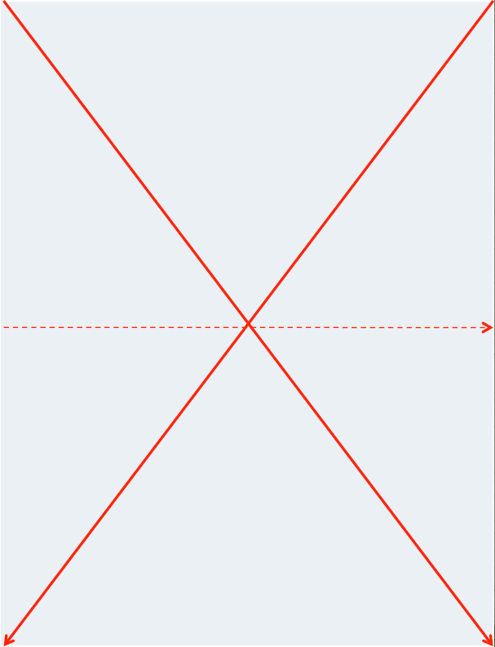
Step 1
Start by making lines diagonally from corner to corner, so that a cross is created in the middle.
That cross is our centerpoint.
Through that we aslo have our horizontal line. Everything above that line will tilt downwards toward the centerpoint, everything below that line will tilt upwards toward the centerpoint. The horizontal line you don´t have to draw.

Slide 4
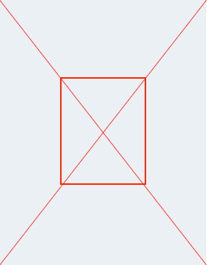
Step 2
Now we are going to make it look like we are standing and looking towards a wall.
Measure 5 cm from the centerpoint along each diagonally line and make a dot.
Draw lines in between each dot.
Now you have made a rectangle in the middle of the paper.

Slide 5
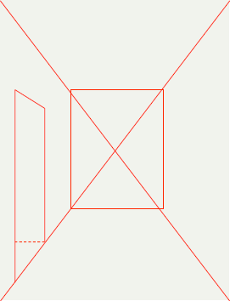
Step 3
Now we will make it look like there is a door on the left side wall.
Remember: All lines that are vertial in reality are also vertical when you draw in perspective.
Draw two lines parallel from the left diagonally line and upwards.
The upper edge of the door should lean towards the centerpoint of the sketch.
If you want the door to transform into a hallway or room you make another line. (see the dotted line.)

Slide 6
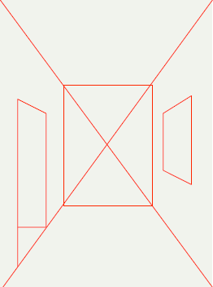
Step 4
We are now going to draw a window on the right wall.
Draw two parallel vertical lines on the wall where you want your window.
The upper and lower edge of the window should point towards the centerpoint.

Slide 7
Now we have reached a certain point…
If you have drawn all the lines as shown in the presentation you should now see a ”depth” in your drawing.
But it isn’t only the inclination of the lines that show perspective. There are more ways of creating depth in sketches. Like drawing the items that are close bigger and the items that are far away in the sketch smaller. With the help of this technique we can enhance the felling of depth in our room.

Slide 8
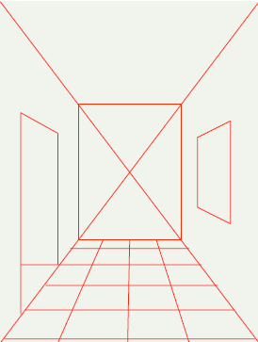
Step 5
Now we are going to make a nice floor inside our room. A checkered floor.
Make three lines over the floor area. From the centerpoint down to the bottom edge of the paper.
Now you make parallel vertical lines across the floor. The closer you get to the bottom edge of the paper the more space you should have inbetween the lines.
Now you have your floor!

Slide 9
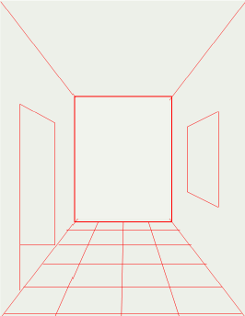
Step 6
Now you have made a good base for your room and you are going to make this your room.
Start by erasing the cross on the farther wall, you no longer need it.
Now you should furnish, color and decorate the environment in this room. Don´t forget what you can see though the window and into the other room next door.

Slide 10
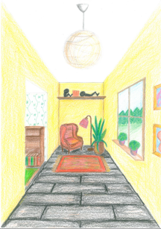
This is an example of how it can look when finished!

